Slide 1


Slide 2
Chapter 18
Concurrency Control Techniques

Slide 3
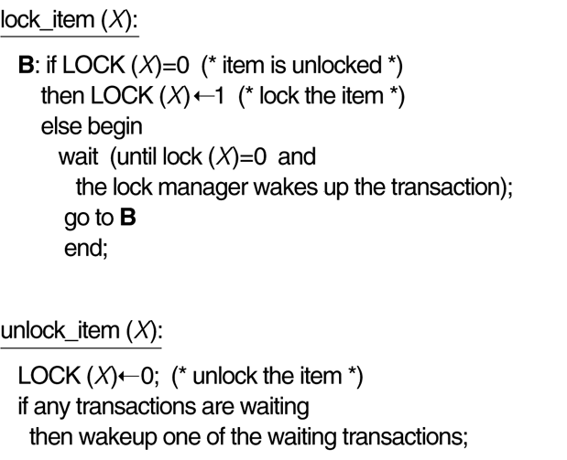
FIGURE 18.1
Lock and unlock operations for binary locks.

Slide 4
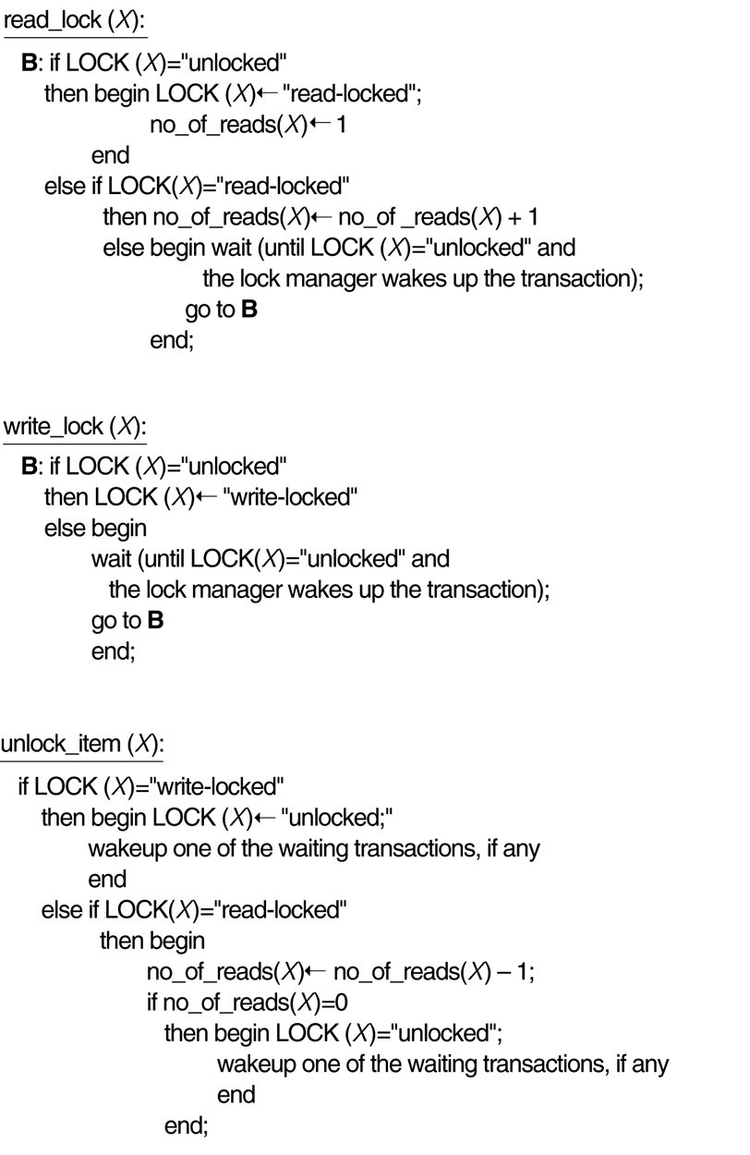
FIGURE 18.2
Locking and unlocking operations for two-mode (read-write or shared-exclusive) locks.

Slide 5
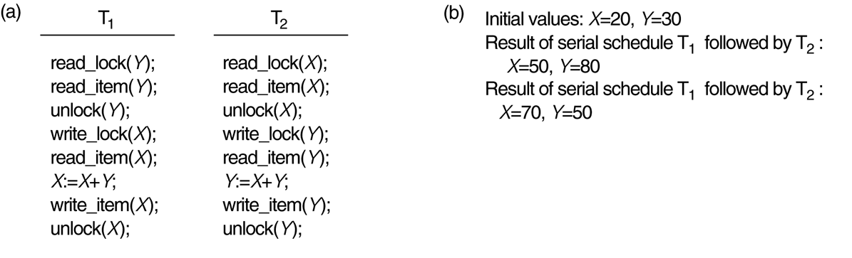
FIGURE 18.3
Transactions that do not obey two-phase locking. (a) Two transactions T₁ and T₂. (b) Results of possible serial schedules of T₁ and T₂.

Slide 6
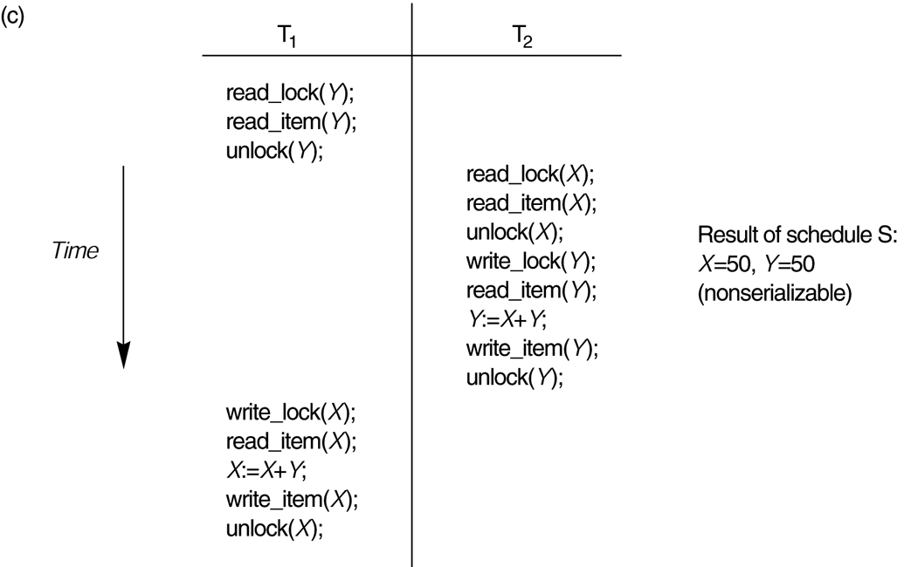
FIGURE 18.3
Transactions that do not obey two-phase locking. (c) A nonserializable schedule S that uses locks.

Slide 7
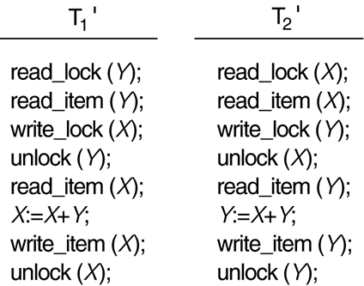
FIGURE 18.4
Transactions T₁′ and T₂ ′, which are the save as T₁ and T₂ of Figure 18.3 but which allow the two-phase locking protocol. Not that they can produce a deadlock.

Slide 8
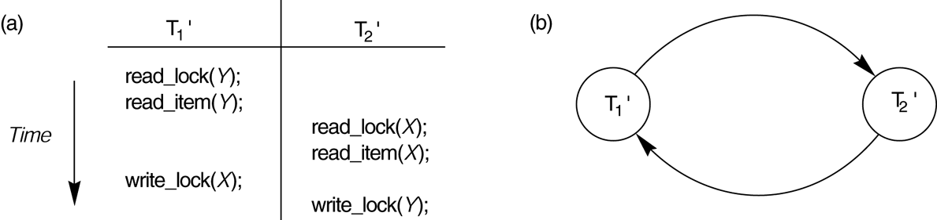
FIGURE 18.5
Illustrating the deadlock problem. (a) A partial schedule of T₁′ and T₂ ′ that is in a state of deadlock. (b) A wait-for graph for the partial schedule in (a).

Slide 9
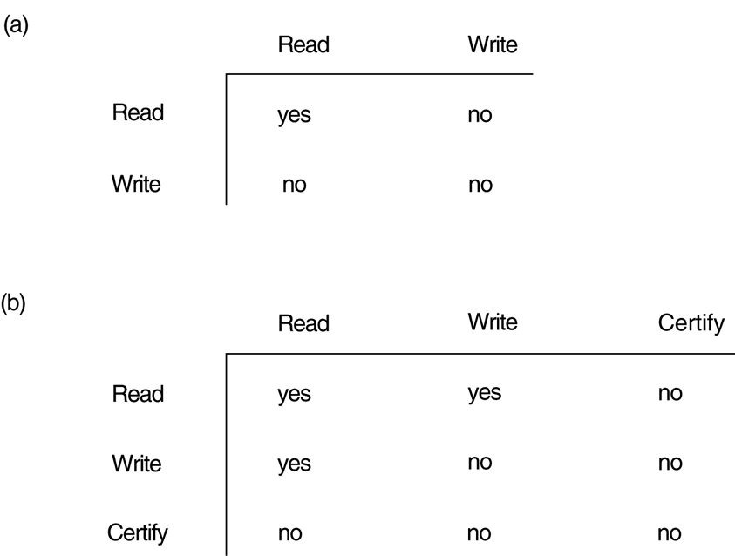
FIGURE 18.6
Lock compatibility tables. (a) A compatibility table for read/write locking scheme. (b) A compatibility table for read/write/certify locking scheme.

Slide 10
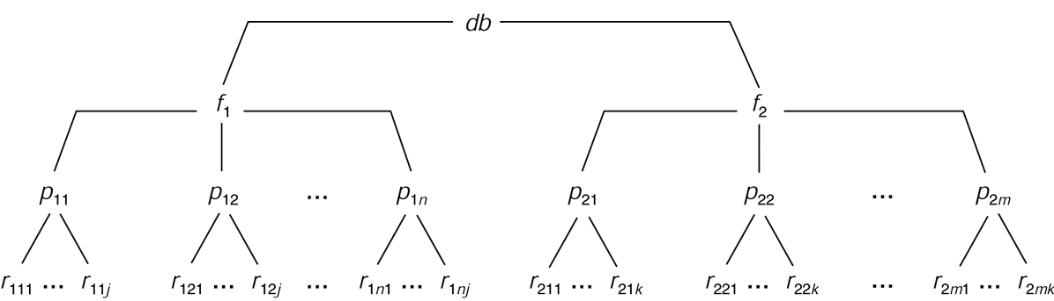
FIGURE 18.7
A granularity hierarchy for illustrating multiple granularity level locking.

Slide 11
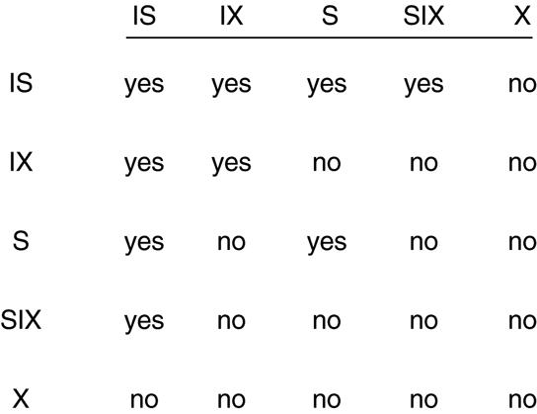
FIGURE 18.8
Lock compatibility matrix for multiple granularity locking.

Slide 12
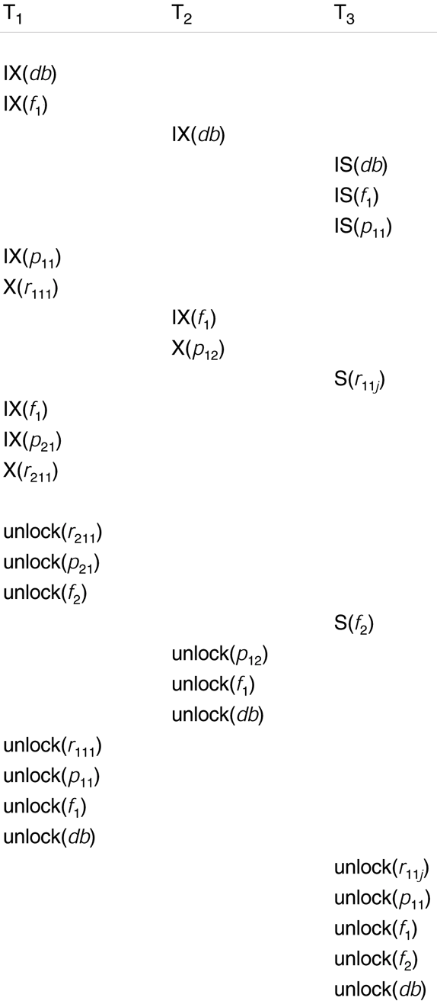
FIGURE 18.9
Lock operations to illustrate a serializable schedule.

